Slide 1
IDB Data Analyst
Analysis of female participation in household labor income
Camila Monzon
October 2025

Slide 2
Motivation
Female labor force participation (FLFP) affects several socially relevant issues such as poverty, inequality, unemployment, education, and gender roles, among others (World Bank, 2012).
At the same time, it is determined by multiple factors: some are driven by individual decisions -such as marriage, and fertility choices- while others are beyond individual control -returns to work, social security systems, and macroeconomic variables- (CEDLAS, 2015).
Changes in macroeconomic environment affect female FLFP directly, but also indirectly through a strong interdependence with the employment status of other household members.(IDB, 2013; CEDLAS, 2015)
The FLFP could be understood broadly as the decision to enter to labor market, or a change in the hours worked.
Countercyclical patterns has been documented in the literature: women tend to enter the labor market to compensate for reduced household income. The “added-worker effect” is typically used to describe this effect CEDLAS (2015).

Slide 3
Motivation - LAC
In the region, it is well documented that here has been a long-term positive trend in female labor force participation betwen 1990 to 2010.
According to World Bank estimates, women’s labor market participation rate increased by approximately 15 percent between 2000 and 2010.
Moreover, female labor income accounted for about 30 percent of the reduction in extreme poverty and nearly one-third of the decline in inequality in LAC during the same period (World Bank, 2012).
However, the region experienced a stagnation in this trend since the early to mid-2000s, coinciding with a strong rise in GDP growth rates.
This applies to all groups of women, but is particularly pronounced among married women and those in more vulnerable households (World Bank, 2012; CEDLAS, 2015).

Slide 4
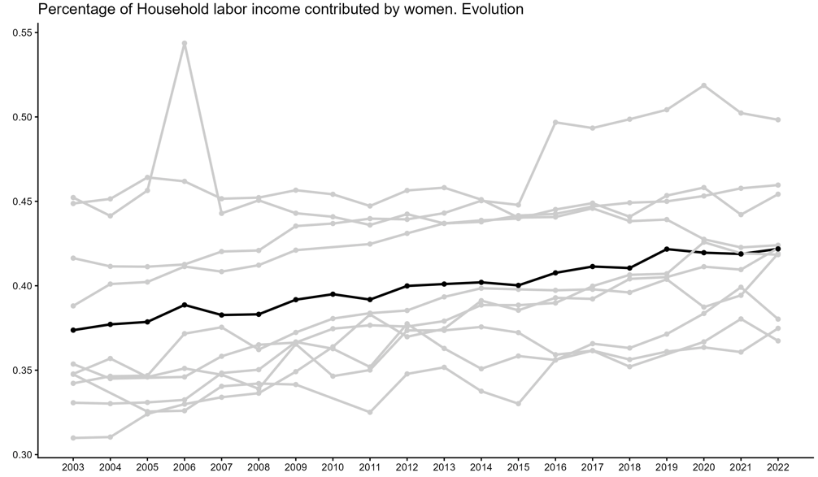
Female participation in household labor income
Data available from the IDB Open Data APIs confirms that the share of women’s labor income within households exhibits a positive trend over the period 2003–2022.
Despite the heterogeneity across countries in the region, the average indicates a slow but steady increase.
In recent years, the trend seems to have decelerated.
Given the importance of female participation in the labor market, it is relevant to explore the determinants behinds this pattern.
Source: own elaboration based on Inter-American Development Bank, 2025, Latin Macro Watch Dataset, IDB Open Data Note:Countries: Argentina, Bolivia, Brazil, Colombia, Costa Rica, Ecuador, Peru, Paraguay, El Salvador, and Uruguay.Period 2003-2022.

Slide 5
This exercise
This study presents a panel data model with country–year fixed effects for ten countries in the region over the period 2003–2022.
The outcome variable analyzed is the Percentage of the Household Labor Income Contributed by Women, used as a proxy for female labor force participation.
For the purpose of the analysis, this variable is interpreted broadly, including both women’s decision of participation in the labor market and their intensity.
The objective is to explain the outcome of interest based on a set of macroeconomic variables and selected socioeconomic indicators.
The estimates are consistent with an increase in female labor participation during periods of weaker macroeconomic performance. Also, some households and population characteristics are relevant determinants.

Slide 6
Data
Open Data APIs. Latin Macro Watch: relevant macroeconomic variables.
Open Data APIs. Social Indicators of Latin America and the Caribbean: some relevant socioeconomic indicators.
The selection of variables aims to include those that most probably could affect women and household decision, following some factors already identified in the literature on female labor force participation and labor income in the region.
The group of countries and the period analyzed (2003–2022) were determined by data availability and the continuity of the series over the longest possible timeframe.
Countries included are: Argentina, Bolivia, Brazil, Colombia, Costa Rica, Ecuador, Peru, Paraguay, El Salvador, and Uruguay.
Observations for BRA 2010, PRY 2019, PER 2005, and BOL 2004 & 2010 were excluded from the regressions due to missing values in several variables, while retaining these countries in the overall analysis

Slide 7





Model
Panel data econometric model with country and year fixed effects.
It controls for unobserved but time-invariant characteristics within each country, as well as for common shocks affecting all countries in each period.
This approach helps mitigate omitted variable bias when those unobserved characteristics are correlated with the explanatory variables.
Percentage of household labor Income contributed by women for country i in the year t
Vector of explanatory variables that vary across countries and over time (including macroeconomic variables and socioeconomic indicators)
average association between within-country changes in the regressors, while controlling for global time effects
country-fixed effects
year-fixed effects
idiosyncratic error term captures unobserved shocks not explained by the model

Slide 8
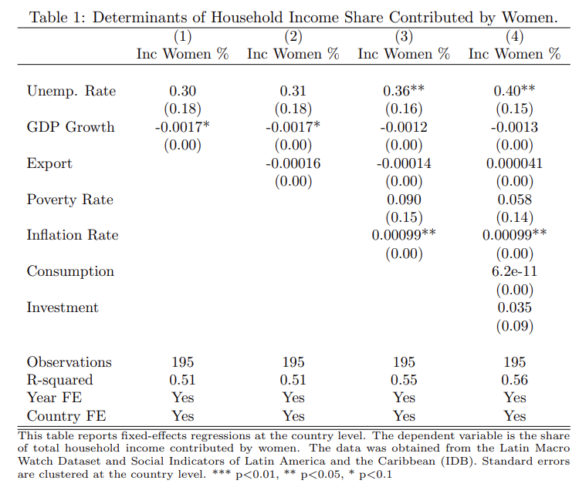
Results

Slide 9
Results
The estimated coefficients of the macroeconomic variables are consistent with an increase in women’s labor participation during periods of weaker macroeconomic performance.
A 1 pp decrease in the annual GDP growth rate is associated with a 0.2% increase in women’s share of household labor income.
Similarly, other proxies of macroeconomic performance reinforce this pattern. A year-on-year increase in the inflation rate is linked to a 0.09% rise in women’s contribution to household labor income.
In turn, the unemployment rate shows an explanatory power that aligns with previous findings in the literature: as unemployment rises, women tend to compensate for the loss of household income.
In the most comprehensive specification, unemployment emerges as the variable with the strongest and statistically significant relationship.
When adding variables such as consumption and investment, the coefficients display the expected signs but are not significant, which is consistent with the correlation exhibits among covariates.

Slide 10
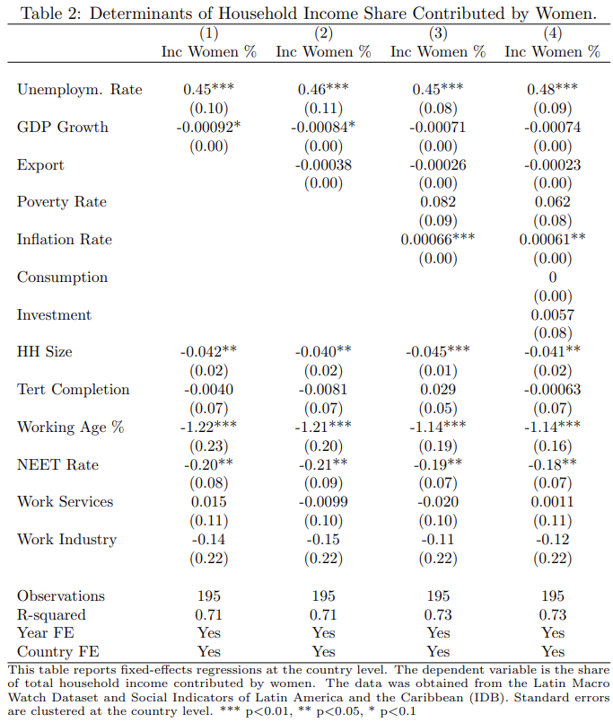
Results

Slide 11
Results
Incorporating other potential determinants, beyond those related to macroeconomic performance, is relevant to explain the dynamics of female labor force participation.
When expanding the model, the significance of the macroeconomic variables is maintained, and we are able to explain more than 70% of the variability in the outcome of interest.
Among the new covariates, household size, the share of NEET, and the working-age population ratio are significant for the model.
Specifically, the results indicate that larger household size is linked with an approximately 4% decrease in women’s share of household labor income. This aligns with the literature: women with children have a lower probability of participating in the labor market compared to women without children.
Moreover, an increase in the share of youth not in employment, education, or training reduces the household labor income contribution of women in that group.
Finally, in economies with a higher proportion of working-age population, it is expected that a larger share of men participates in the labor market, given the gender gap in employment rates observed in the region.

Slide 12
Limitations
The exercise provides an indication of correlations between relevant macroeconomic variables and social preferences that are associated with women’s labor income and its corresponding share within the household.
This study does not aim to establish causal relationships between the variables analyzed; rather, it is descriptive in nature. With this setting and data, we can not rule out omitted variable bias, reverse causality or other confounding factors.
Furthermore, because the analysis does not rely on microdata, it is not possible to perform decomposition exercises to understand whether certain types of households or women are more affected than others (e.g., households with or without children, by educational level, or by sector of employment).
In this regard, it is also not possible to disentangle whether the observed dynamics are driven by changes in working hours or by women entering or exiting the labor market (extensive versus intensive margin effects).
Given the limitations imposed by the available data sources, the variables used here does not fully cover all the relevant dimensions. For example, social security expenditure, fertility, marriage rates, and other relevant covariates could not be included in the model.

Slide 13
Policy insights
Given that labor market participation and its intensity are determined by multiple factors, comprehensive policies are required — not only those aimed at increasing female employment rates, but also those that influence underlying incentives and constraints.
The incentive to engage more actively in the labor market tends to intensify under unfavorable macroeconomic or cyclical conditions. This highlights the challenge of designing policies that help retain women in the labor force even beyond those temporary contexts.
Such policies should facilitate a sustained and smooth transition to and within the labor market. Programs that promote entrepreneurship, professional training, and job-readiness could be particularly beneficial in this regard.
Moreover, it would be desirable to implement policies that ease the constraints women face in entering or remaining in the labor market—such as those providing greater flexibility, including parental leave and child or adult care services.
Finally, beyond aggregate regional trends, it is essential to consider country-specific contexts and needs to design policies that are both effective and contextually relevant.

Slide 14
Appendix
List of variables used for the analisys
From Latin Macro Watch (LMW)
CPI (period average inflation, %)
Consumption (constant prices, millions of LCU)
Net exports
GDP (constant prices, year on year growth, %)
From (SILAC)
Percentage of household labor Income contributed by women
Percentage of unemployed population
Percentage of households with female economic heads
Percentage of population in working age
Percentage of the population in poverty
Percentage of women
Completion rate in secondary education
Completion rate in terciary education
Household size
Total investment
Percentage of young people between 15 and 24 years old who are "Not in Employment, Education or Training"

